Slide 1
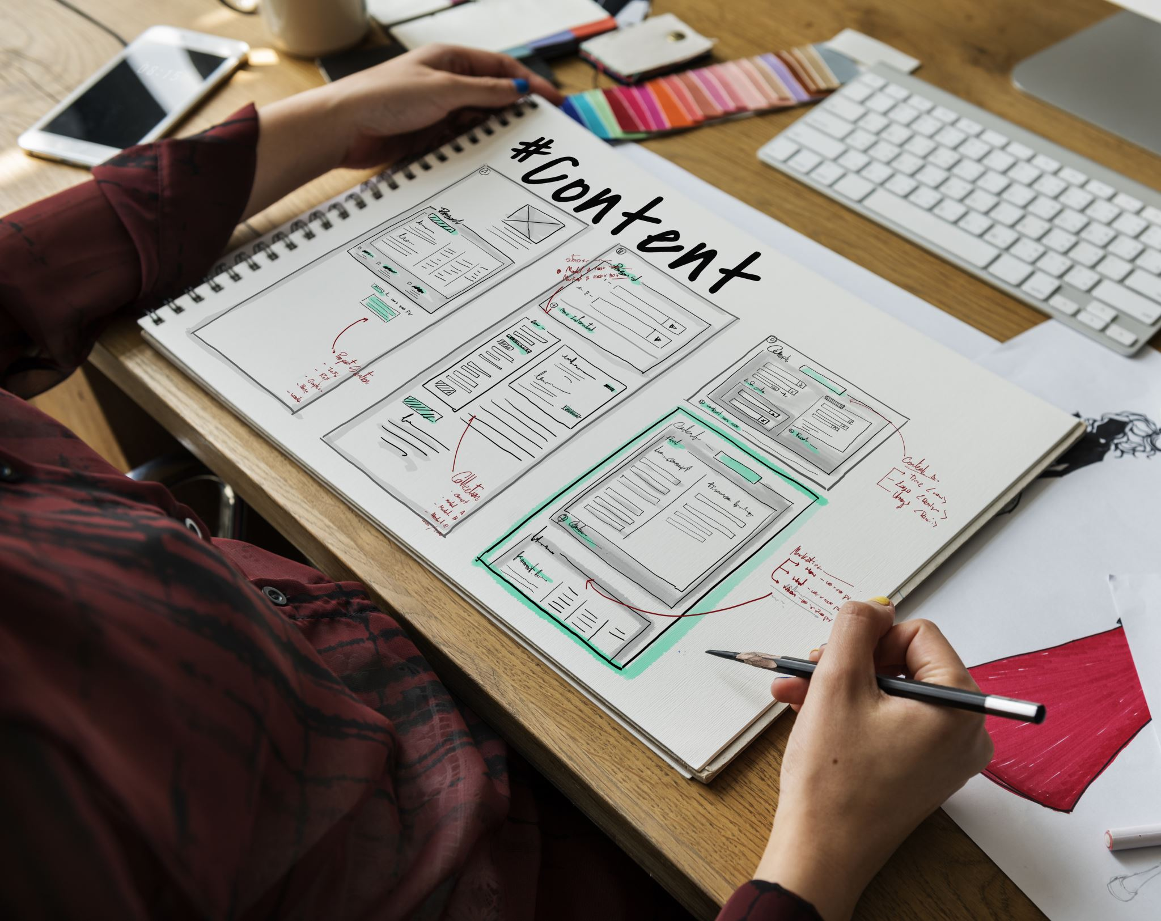
Task Management App
Human-computer interaction project proposal
Presented by: [insert name here] - [insert ID here]
Other Team members:
[insert name here] - [insert ID here]
[insert name here] - [insert ID here]
Nour Khaled Mohamed - 22011319
[insert name here] - [insert ID here]
[insert name here] - [insert ID here]

Slide 2

Objectives
Using Python-PyQt,
An application that helps users:
Manage their time efficiently using Pomodoro Technique.
Organize their tasks and categorize them into projects or lists.
Set due dates for tasks with Notifications and reminders for upcoming due dates.
Filter tasks by status, priority, or due date.
Track their progress in completing their tasks.

Slide 3
Storage/Database
If it's simple: Using JSON or INI files to store settings and task data is sufficient.
If it's more complex: Consider using SQLite for more structured and relational data storage.

Slide 4
Core Features
Task Management
Task Organization
Due Dates and Reminders
Search and Filter
Pomodoro Technique
Progress Insights & Analytics
Calendar View
Progress Tracking

Slide 5

Task Management
Create new tasks with titles and descriptions.
Edit existing tasks.
Delete tasks.
Mark tasks as completed or pending.
Set priorities (high, medium, low).

Slide 6
Task Organization
Categorize tasks into projects or lists.
Tagging system for better organization.
Subtasks for breaking down larger tasks.

Slide 7

Due Dates and Reminders
Set due dates for tasks.
Recurring tasks (daily, weekly, monthly).
Notifications and reminders for upcoming due dates.

Slide 8

Search and Filter
Search functionality to find tasks quickly.
Filter tasks by status, priority, or due date.

Slide 9

Pomodoro Technique
Choose your topic.
Set a timer for 25 minutes.
Work on the topic until the timer goes off.
Take a short break (usually 5 minutes).
After every fourth Pomodoro, take a longer
break (usually 15-30 minutes).

Slide 10
Progress Insights & Analytics
Provide insights into task completion.
How many tasks are completed by day.
Average completion time, most productive times, etc.

Slide 11

Calendar View
Offer a calendar view for a visual representation of upcoming deadlines and events.

Slide 12

Progress Tracking
Offer a progress bar or percentage completion for tasks that involve multiple steps or subtasks.

Slide 13
User Interface Features
Customizable Themes:
Light and dark modes.
Option to change color schemes.
Drag and Drop:
Reorder tasks using drag and drop.
Responsive Design:
Ensure the UI adapts to different screen sizes.
Context Menus:
Right-click options for quick actions (edit, delete, mark complete).

Slide 14

Thank you, Ask me something!

